Slide 1

Hospital Readmission & Resource Utilization Analytics
Strategic Data Intelligence for Operational Excellence

Slide 2


The Challenge: Operational Inefficiencies
Optimize Discharge Processes
Enhance Patient Education
Close post-discharge care gaps quickly.
Provide targeted teaching and resources.
Identify Readmission Drivers
Monitor & Allocate Resources
Analyze factors causing 28% readmissions.
Use analytics for efficient resource use.

Slide 3



Strategic Objectives
Establish baseline metrics and identify high-risk readmission patterns
Optimize bed allocation and patient flow efficiency
Pinpoint operational bottlenecks by department and care pathway
Enable evidence-based resource allocation and clinical decision-making
Readmission
Strategy
Resource
Analytics

Slide 4
Data Overview
1,000+ Records
12 Months Data
Multi-Department
Real-time Metrics

Slide 5





Analytical Methodology
Data Validation
Ensure accuracy and consistency of records
Date Standardization
Apply uniform datetime formats
Duplicate Removal
Eliminate redundant data entries
Metric Derivation
Calculate LOS, occupancy, and readmission flags
Technology Stack: Python, Pandas, PostgreSQL, Jupyter Notebook

Slide 6
Key Performance Indicators
1,000+
28%
8
81%
Total Admissions
Readmission Rate
Average Length of Stay
Bed Occupancy
Days per patient
48%
Discharge Efficiency
Validated through PostgreSQL aggregation and statistical analysis

Slide 7
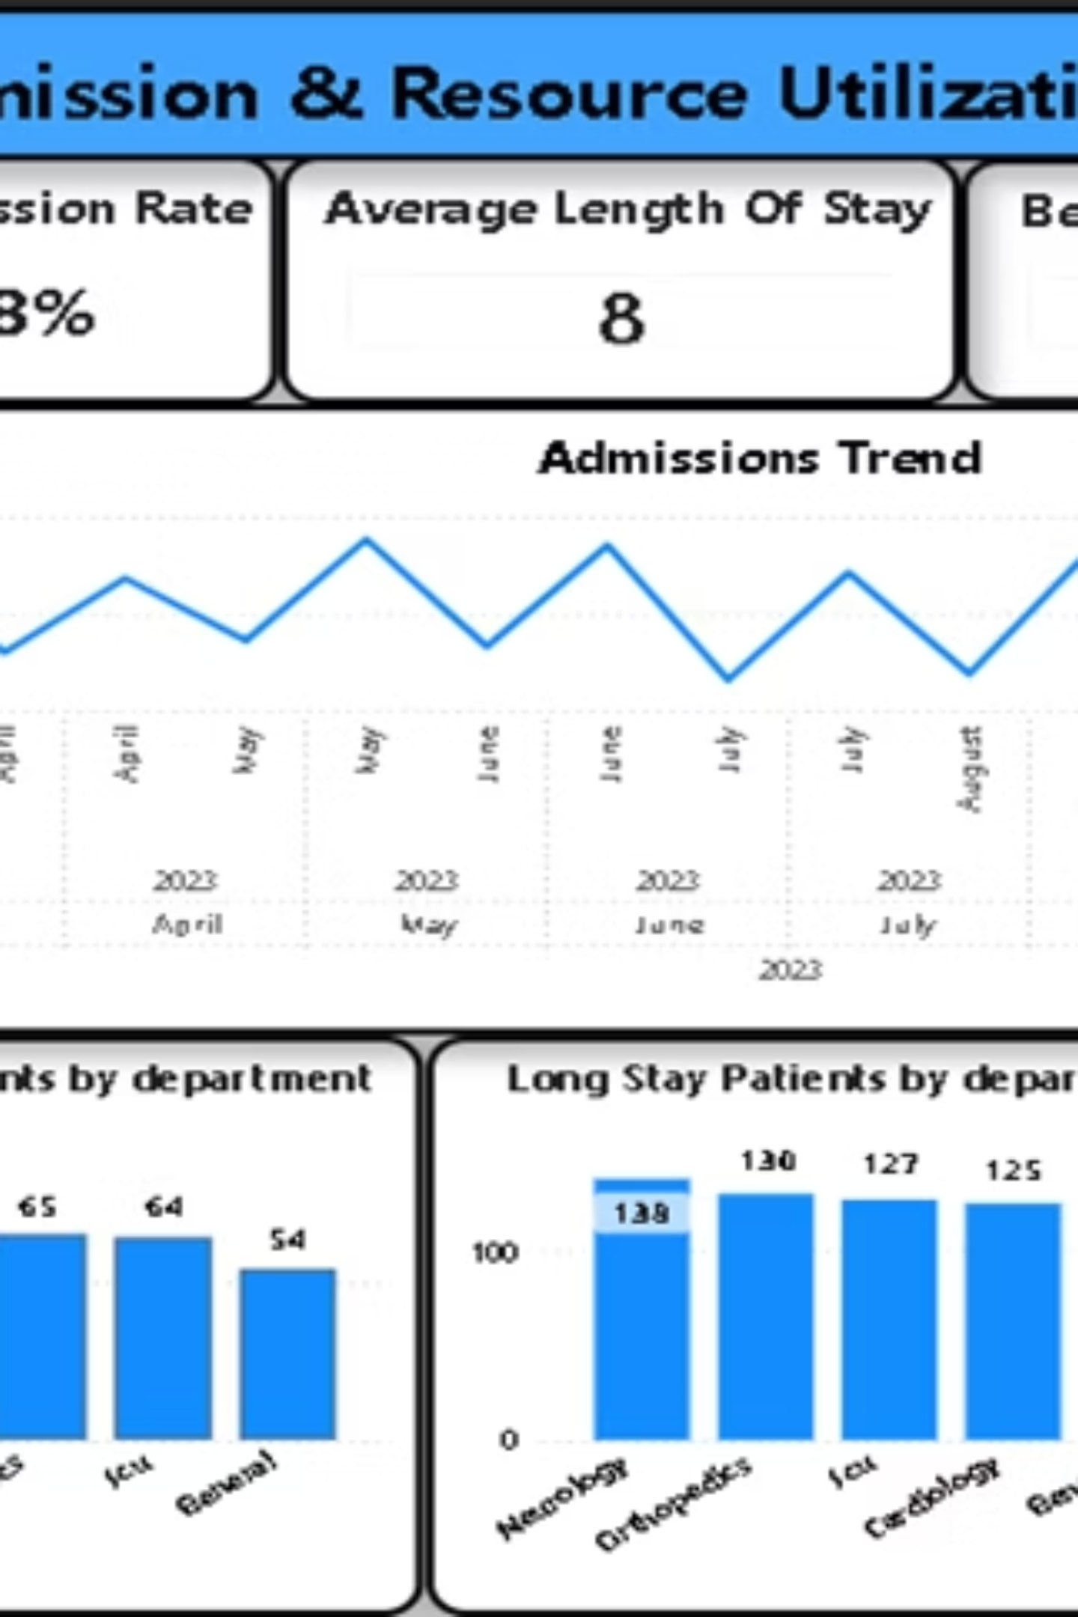
Analytics Dashboard & Key Findings
Real-time KPI Monitoring
Trend Analysis Across Admission Patterns
Department-level Performance Comparison
Interactive Filtering & Drill-down Capabilities

Slide 8

Critical Findings by Department
Neurology Department
General Medicine
33% readmission rate (highest) with 9.2-day average stay
23% readmission rate (lowest) with efficient discharge protocols
Cardiology
81% bed occupancy indicates capacity constraints during peak periods

Slide 9
Implementation Roadmap
Phase 1: Deploy Post-Discharge Monitoring
1
For Neurology and high-risk patients to reduce readmissions.
2
Phase 2: Implement Early Discharge Planning
To reduce extended patient stays across all departments.
Phase 3: Establish Best Practice Sharing
3
Apply General Medicine strategies and successful protocols across all departments.
4
Phase 4: Optimize Bed Allocation
Proactively monitor occupancy trends and allocate beds efficiently.
Phase 5: Establish Monthly Governance Reviews
5
Dashboard-driven governance with KPI benchmarking for continuous improvement.

Slide 10
Strategic Impact & Recommendations
Our comprehensive strategy is designed to deliver significant, measurable improvements across key operational and financial metrics. By focusing on targeted interventions and data-driven decision-making, we anticipate a transformative impact on patient care and resource utilization.
Expected Outcomes
Recommendations
15-20%
5-10%
Readmission Reduction
Occupancy Improvement
Neurology Discharge Protocols
2-3 Days
$2.1M+
Daily Occupancy Dashboard
LOS Reduction
Annual Savings
Cross-Dept Task Force
Quarterly Leadership Reviews

